Slide 1
Digital Twin Based School Bus Time Arrangement
By Weihao Wang, Jingran Shen, Zhao Li

Slide 2
Digital Twin
A modeling and simulation idea: use simulator, and run algorithm based on real data, to measure how better the algorithm is.
Raised by Dr. Michael Grieves in 2003.
Reference: ridesharing platform of Cargo architecture.

Slide 3
School Bus Situation
School bus has constant route, but different time schedule can affect quality of service.
Problem: to dynamically arrange time schedule of school bus to satisfy the need of students.
Three part to solution: algorithm, simulator, data.
Constant: bus stops.

Slide 4
Why Do We Need Simulator
Use simulator to measure algorithm, determine how well it is.
Save a large number of time, saving cost of testing algorithm.
Find the best algorithm that satisfy the requirement.
Adjust the arguments in algorithm.
From evaluation to prediction!

Slide 5
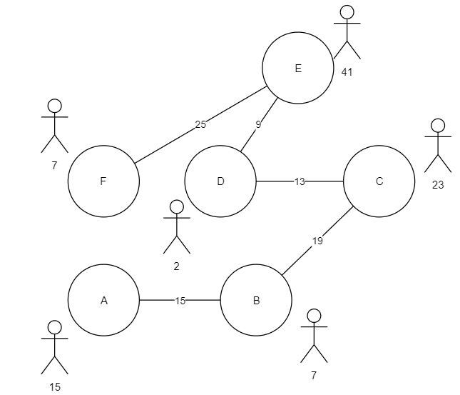
Problem instance

Slide 6
Problem instance
Station: some students are waiting in stations, waiting bus to reach their destination.
Edge: distance between stations, longer edge has longer time.
School bus running in graph to send all students to their destination.
Challenge: number of bus is limited, capacity of bus is limited.

Slide 7
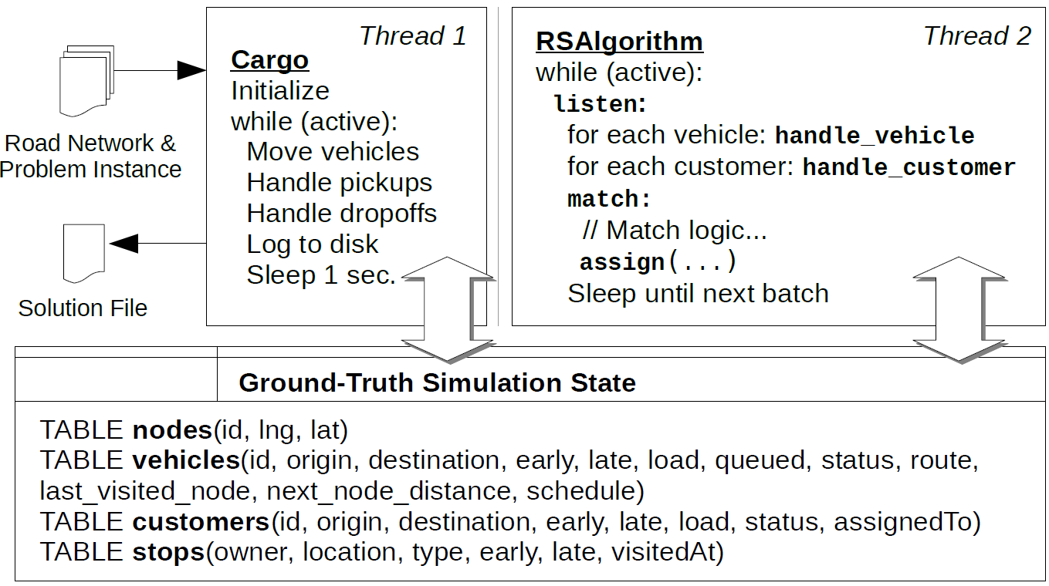
The cargo Algorithm
(VLDB2019)

Slide 8
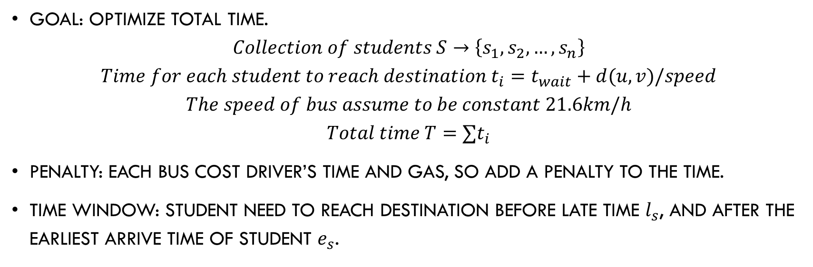
Another Step
Goal: optimize total time.
$$Collection of students S→\left\{s_{1}, s_{2}, …, s_{n}\right\}$$
$$Time for each student to reach destination t_{i}=t_{wait}+d(u, v)/speed$$
$$The speed of bus assume to be constant 21.6km/h$$
$$Total time T=∑t_{i}$$
Penalty: each bus cost driver’s time and gas, so add a penalty to the time.
Time window: student need to reach destination before late time $l_{s}$, and after the earliest arrive time of student $e_{s}$.

Slide 9
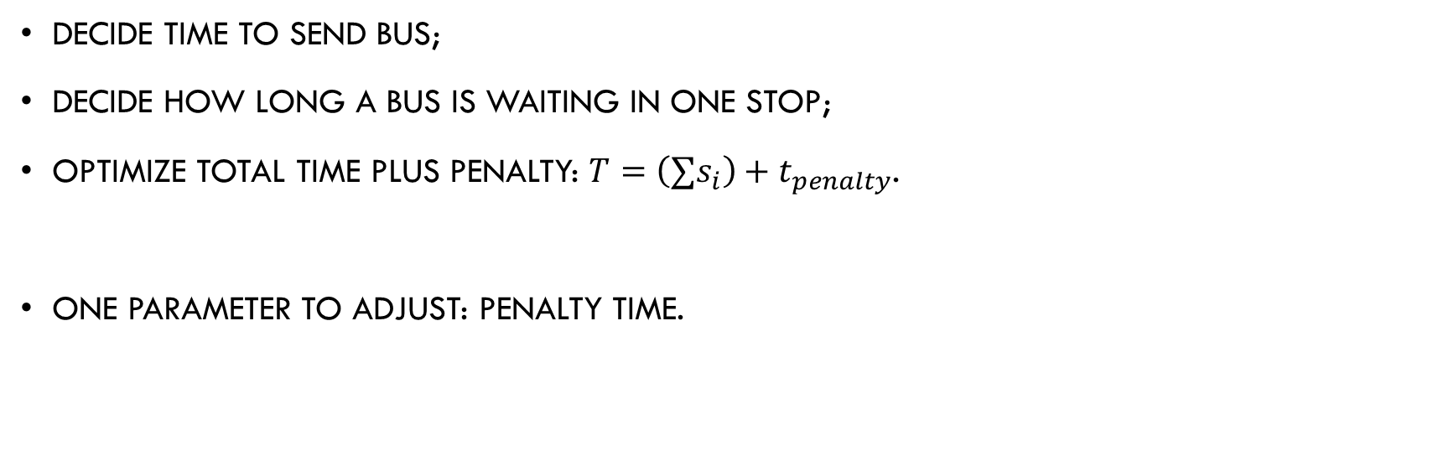
Algorithm Goal
Decide time to send bus;
Decide how long a bus is waiting in one stop;
Optimize total time plus penalty: $T=\left(∑s_{i}\right)+t_{penalty}$.
One parameter to adjust: penalty time.

Slide 10
Simulator Side
Measure an algorithm, according to evaluate several parts:
Total waiting time plus penalty;
Longest cost time;
Number of buses sent;
Percentage of students later than late time in time window.

Slide 11
Data of Simulator
Real data from school bus.
Data we need: Bus stops, number of students waiting for bus in each stop, course schedule of students (to decide time window), total number of buses.
Data sent to algorithm: bus stops, current number of students in each stop, course schedule, total number of buses.
Obvious we need an online algorithm!

Slide 12
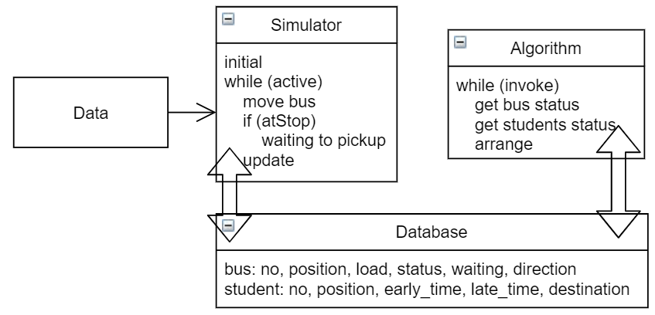
Our architecture

Slide 13
Comments
Simulator and algorithm are running together, which means there should be a synchronization between them.
Algorithm arrange 2 things: whether to send a new bus, and how long a bus should waiting at a station.
Each bus has a capacity constant, means how many students it can carry. The load means current number of students on bus.
Simulator output a measurement of algorithm according to above 4 targets.

Slide 14
Task Division and time
Data: Jingran Shen;
Algorithm: Weihao Wang;
Simulator: Zhao Li.
Time: data -> simulator -> algorithm.
Backup plan: no waiting time set, bus arrives, pickup as many students and immediately goes away.

